Slide 1



MY PROFILE
JOIN A NEW GAME
saskia: i want to play – who is available?
jonas: give me 5 minutes…
ONGOING GAMES
Photo
saskia
vs.
jonas
Photo
sassi
vs.
jonas
Enter your message…
Photo
saskia
vs.
jonas

Slide 2
MY PROFILE
ACHIEVEMENTS
sassi
A
A
A
XP:
227
Rank:
#14
A
A
A
GAME HISTORY
saskia
WIN
11 : 5
03.05.2023
17:43h
+ 78 XP
sassi
LOSS
3 : 11
03.05.2023
16:47h
+ 0 XP
saskia
LOSS
10 : 11
03.05.2023
16:41h
+ 0 XP
sassi
WIN
11 : 10
02.05.2023
18:45h
+ 98 XP

Slide 3

MY PROFILE
ACHIEVEMENTS
saskia
A
A
A
XP:
227
Rank:
#14
A
A
A
GAME HISTORY
saskia
WIN
11 : 5
03.05.2023
17:43h
+ 78 XP
sassi
LOSS
3 : 11
03.05.2023
16:47h
+ 0 XP
saskia
LOSS
10 : 11
03.05.2023
16:41h
+ 0 XP
sassi
WIN
11 : 10
02.05.2023
18:45h
+ 98 XP

Slide 4
MY PROFILE
ACCOUNT SETTINGS
Nickname:
saskia
Two-Factor-Authentication:
GAME SETTINGS
Game Design B
Game Design C
SAVE CHANGES
CANCEL

Slide 5
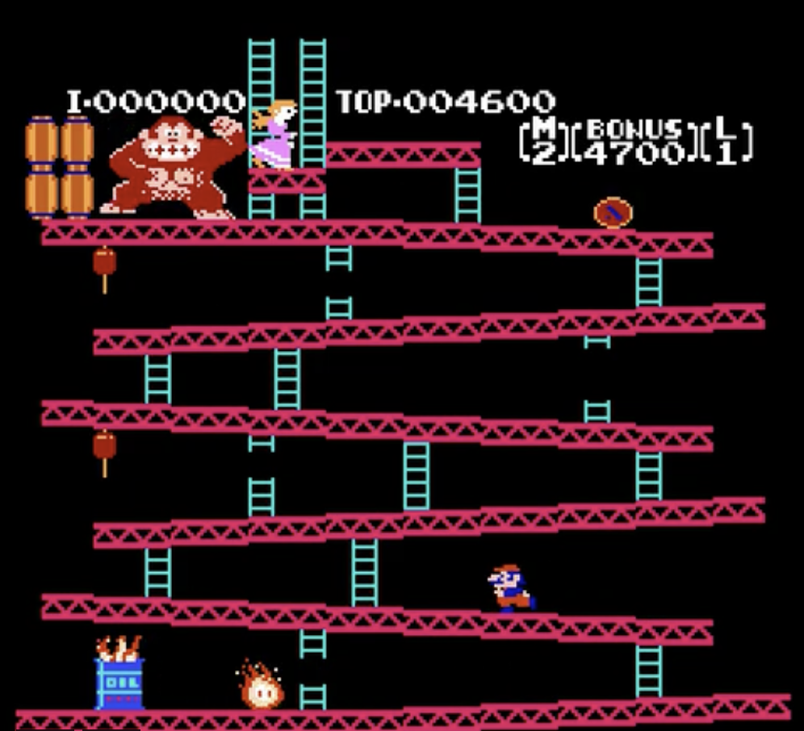
MY PROFILE
WAITING FOR AN OPPONENT …
CANCEL

Slide 6
MY PROFILE
sassi
saskia
5
O
3
END GAME

Slide 7

MY PROFILE
sassi
saskia
11
3
YOU LOST
EXIT

Slide 8

MY PROFILE
sassi
saskia
11
3
YOU WON
EXIT

Slide 9
MY PROFILE
Chat

Slide 10
MY PROFILE
Ranking

